Slide 1
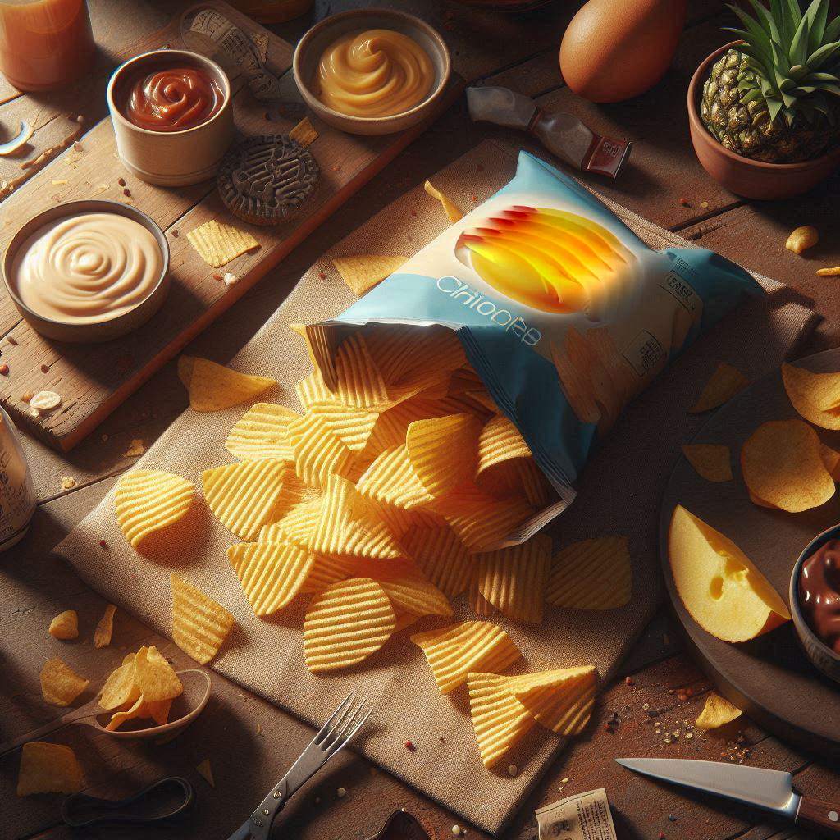
Category Review: Chips
September 2024
Retail Analytics
Brand note: If client logo is not required, use alternate title page layout right click slide thumbnail > Layout > Title

Slide 2
Notes:
To view Privacy video explaining how important data privacy is to Quantium, please click here: https://www.youtube.com/watch?v=Zq1QDAkoRzU
or here Q:\Company Reference\Brand & Design\Brand videos\Q Privacy.mp4
At Quantium, we believe that data is the behavioural footprint of humanity and that it has to be treated with the utmost care and responsibility.
Histories, attitudes, indeed lives are stored within it in ways that aren’t always apparent – and that’s what makes its potential so powerful.
To work with it responsibly, sensitively, we set ourselves the highest data privacy protection and governance standards.
We have spent 17 years perfecting privacy-by-design and secure-by-design principles. Central to this is not holding any personally identifiable information about people –
we neither receive it, and put the necessary protections in place to be unable to decipher it.
Every aspect of handling data is safeguarded: from its de-identification, to its encryption – data security is paramount and of the highest grade.
We pride ourselves on gaining the trust of iconic organisations around the world through years of securely working with their data,
and in turn the trust that builds with their stakeholders.

Slide 3
Executive summary
01
Task 1
December Month clocks the highest sales.
175 Pack size is the most sold size wise.
Kettle, Smith, Doritos, Pringles, RRD are the top 5 brands.
Mainstream buyers contribute to major chunk of Chips sale.
Older families and Young families are the highest average category spenders in the store.
02
Task 2
Store 77 resembles the metrics of Store 233, the analysis shows the trial was successful.
Store 86 resembles the metrics of Store 155, the analysis shows increase in customer but similar sales numbers.
Store 88 resembles the metrics of Store 237, the analysis shows the trial was successful.

Slide 4
01
Target Customer
and Customer Behaviour

Slide 5
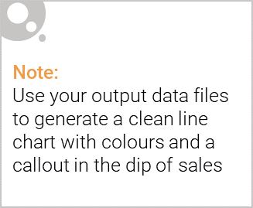
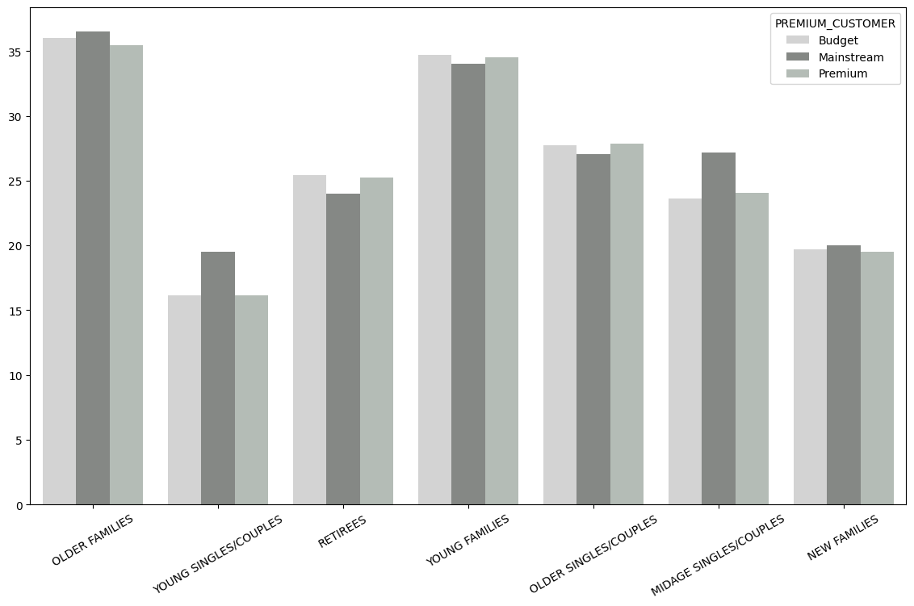
Chips Sales Overview:
21%
175g
~60%
Avg. Sales increase in December
Most bought size pack
Retirees, Old/Young Singles/Couples
Top 5 Chips Brand by quantity sold
Avg. Sales per Segment

Slide 6

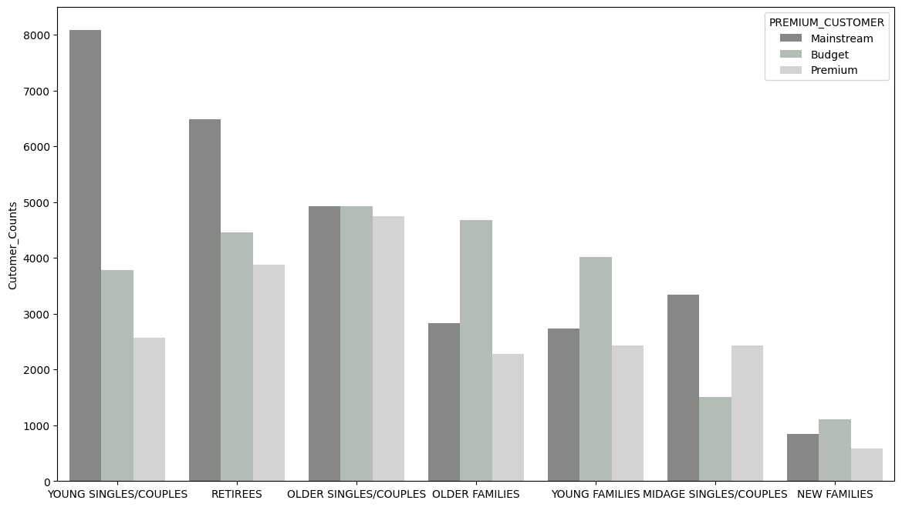
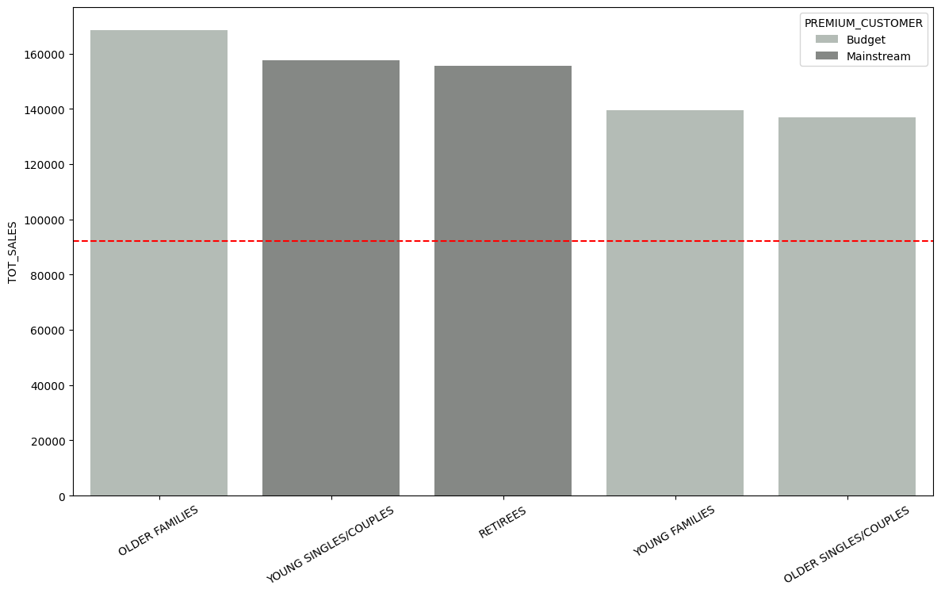
Target Customer Segment:
Customer Count Per Segment
Top 5 segment by Total Sales
Sales Mean
Mainstream (Young Singles/Couples & Retirees)

Slide 7
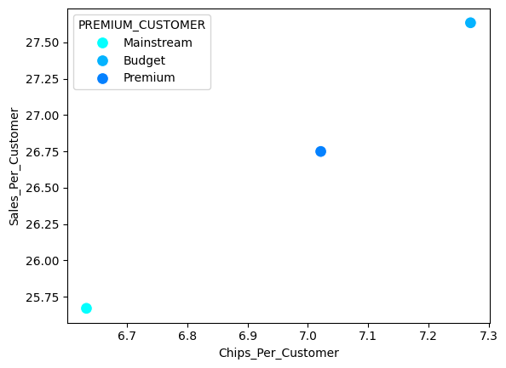
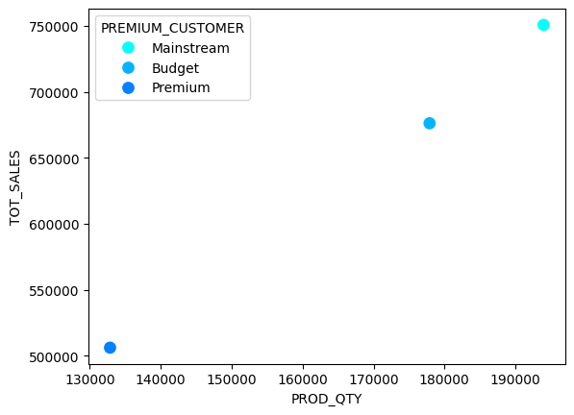
Customer Spending Behaviour on Chips:
(Sales vs Quantity) Per Customer Data
Total (Sales vs Quantity) Data

Slide 8
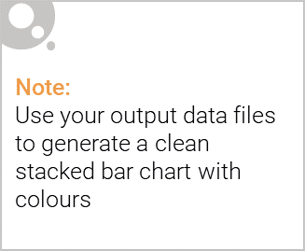
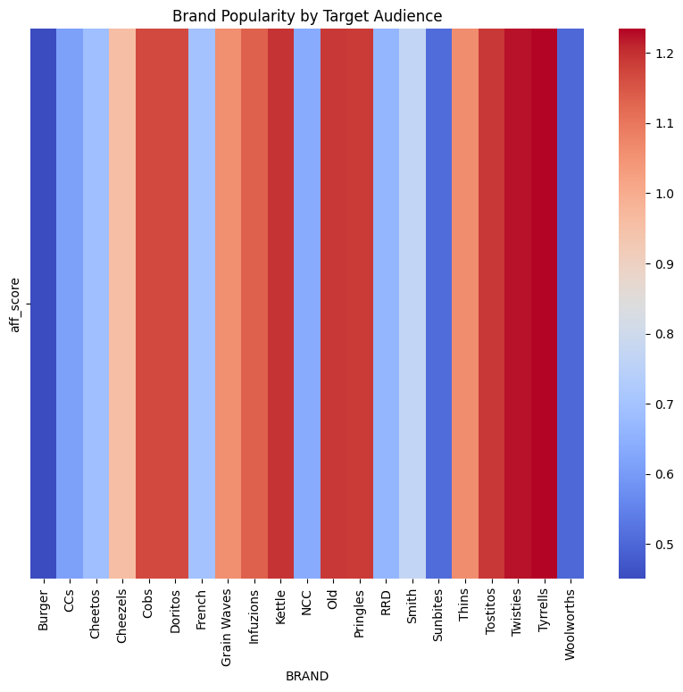
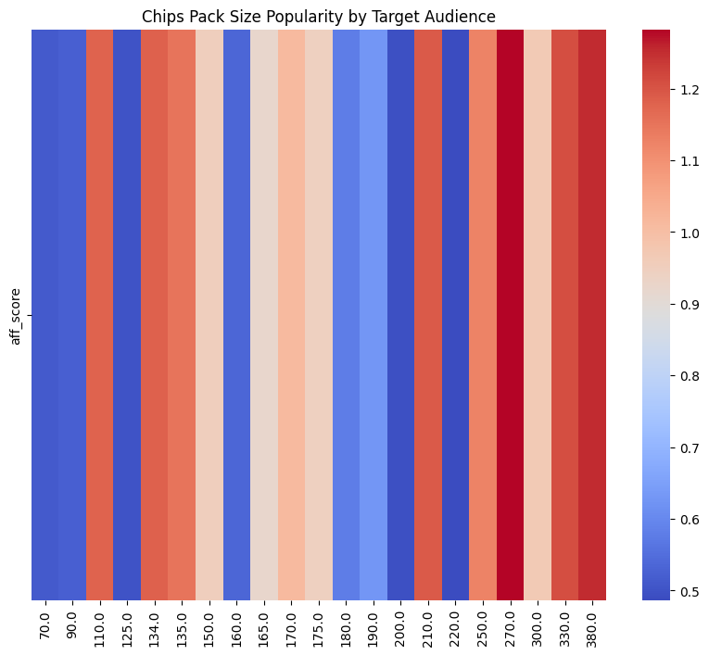
Editable (delete this)
Target Customer Segment Overview:
~11%
~8%
4.08
(Mainstream: Young Singles/Couples)
Total Customer Counts
Total Sales Amount
Avg. Price Per Chips
Affinity Heat Map
Preferred Brands: Tyrrells, Twisties
Preferred Pack Sizes: 270g, 380g

Slide 9
02
Trial store performance

Slide 10
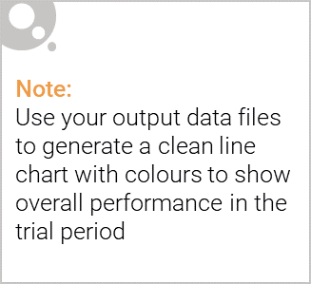
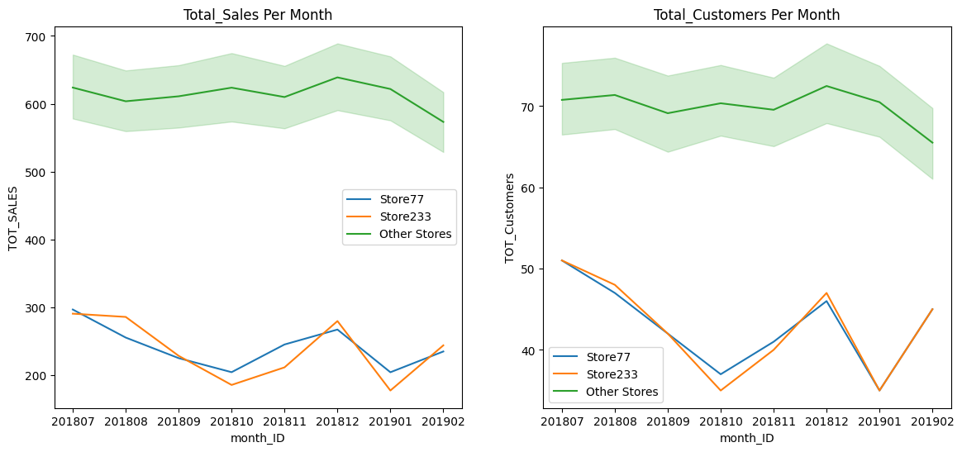
Control store:
Store77
Store86
Store88
Control Store: 233
Control Store: 155
Control Store: 237
Control Stores resembles the sales and customer metrics to that of the trial stores before the trial period starts.
Example of Store77

Slide 11
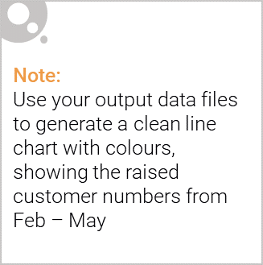
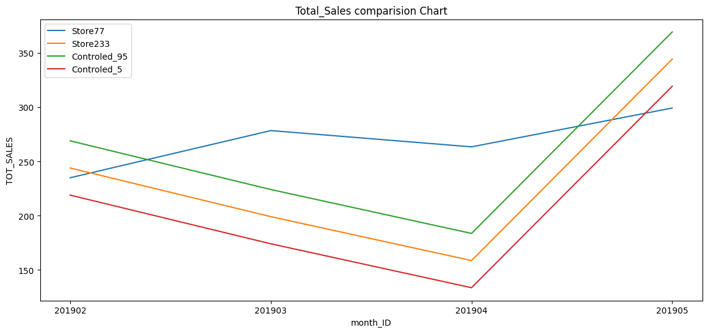
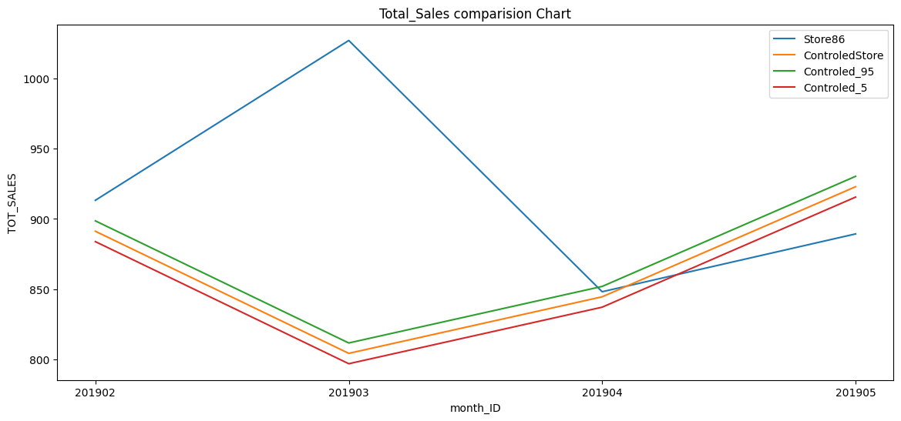
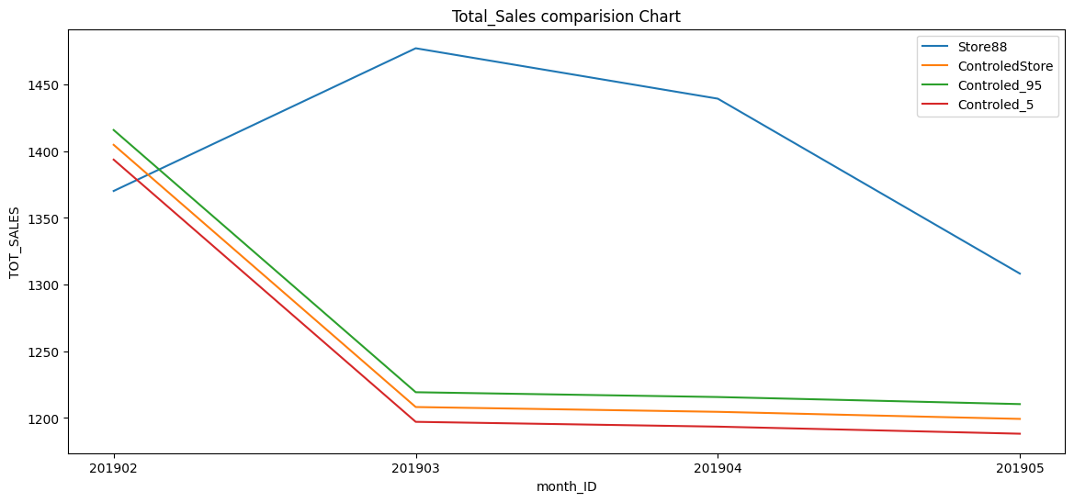
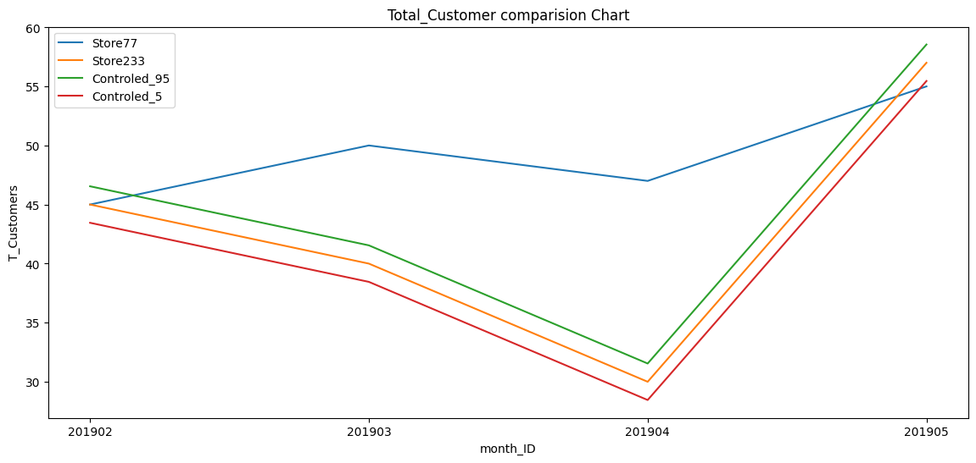
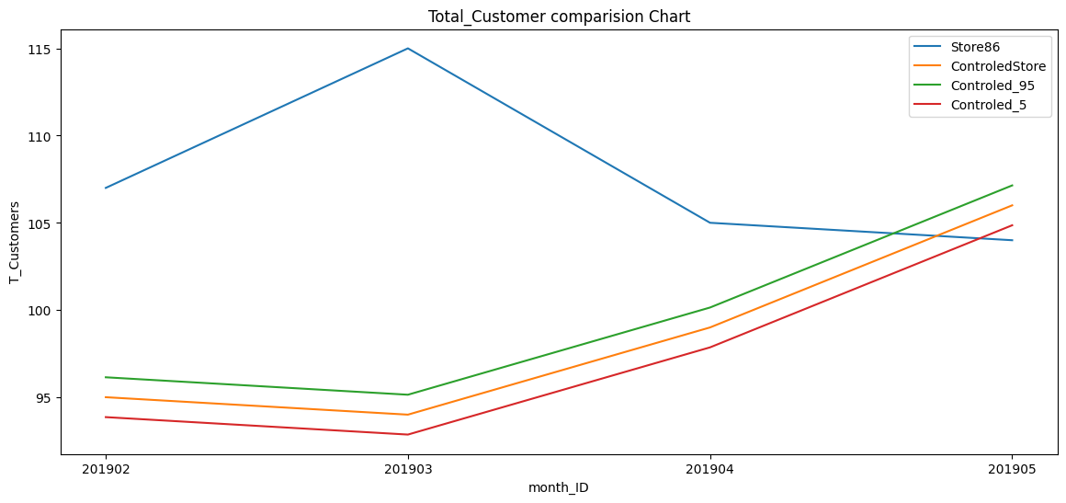
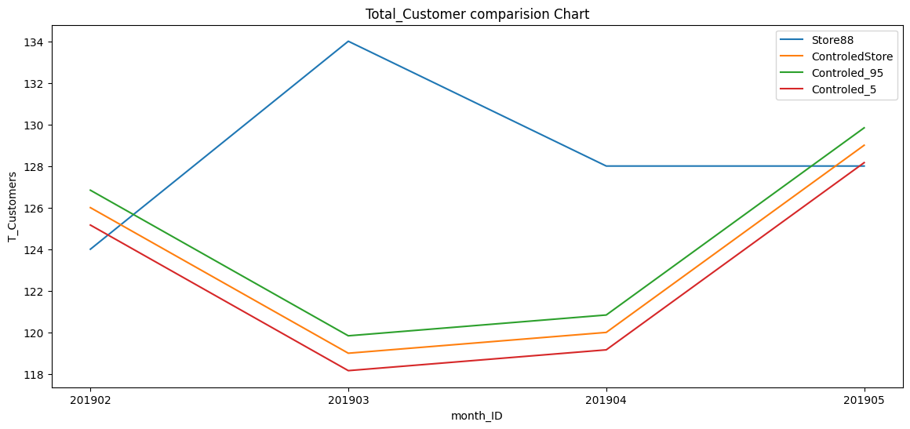
Trial Performance :
Store 77
Store 86
Store 88
Customer Sales

